Slide 1



A barrier to global plant invasion ecology
gaps in trait availability for alien species
Matthias Grenié, GloNAF consortium, and Marten Winter MacroFest 2022 ‑ July 5th 2022

Slide 2

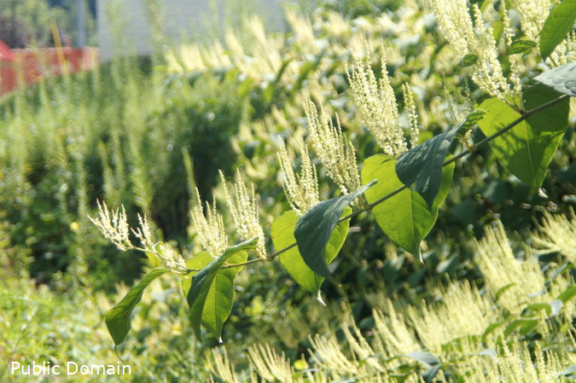
Alien species have strong ecological consequences
Asian knotweed
Fallopia japonica
Invasive species that
replaces native species
Strong effects
on ecosystem functioning
Cost to remove (in Germany)
annually ~€32.3 million (Reinhardt et al. 2003)
There are thousands of alien species globally
We need to increase our understanding of their ecology

Slide 3

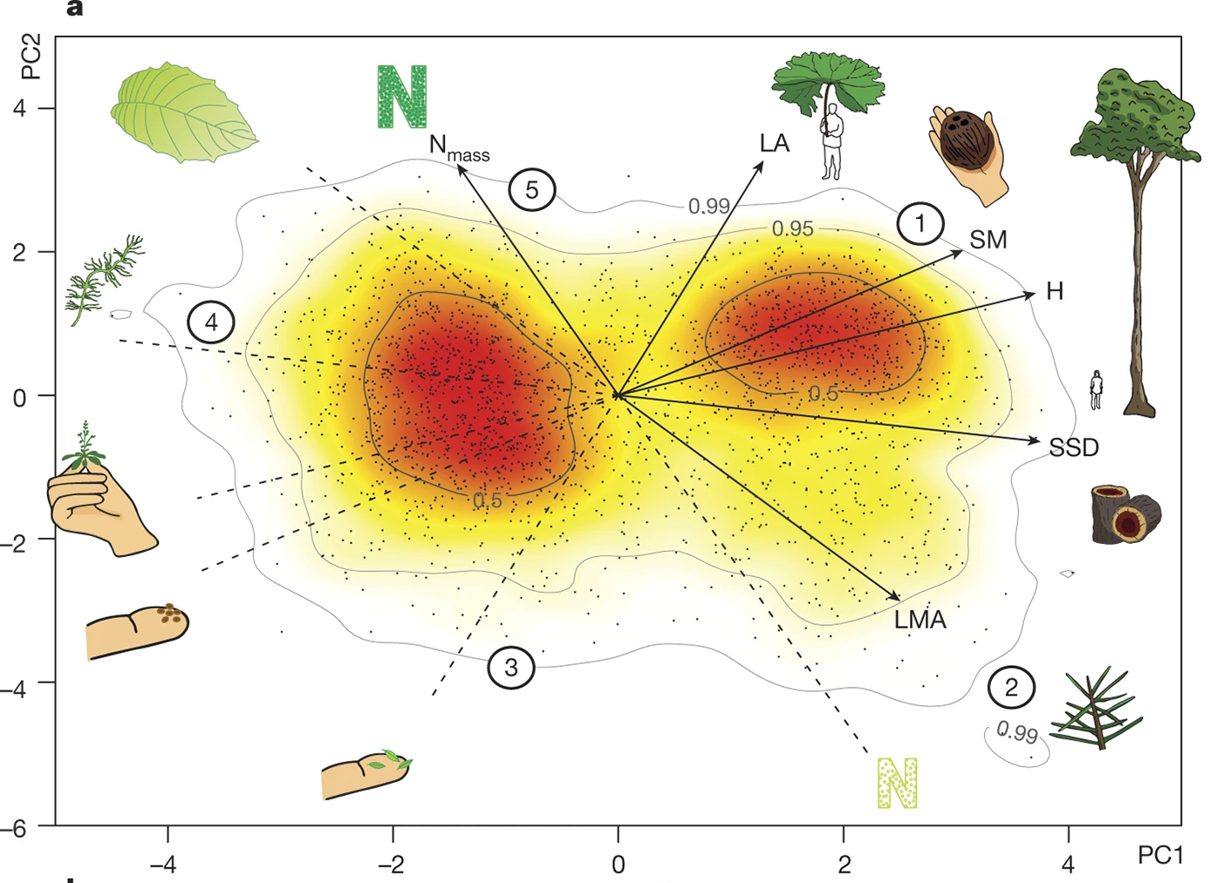
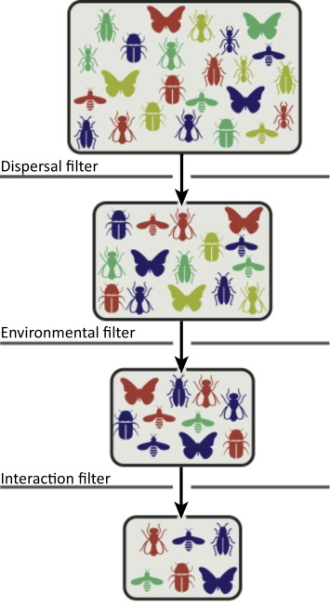
Using functional traits to advance invasion ecology
Functional traits let us gain insight to the ecology of species (Díaz et al. 2016)
Functional traits explain species relationships within communities through community ecology/coexistence theory
We need massive trait data on alien species
What do we know of functional traits of alien species at global scale?

Slide 4


Methods
Open Global Plant Trait Databases
Alien Species Status and Distribution
Taxonomic Harmonization (Grenié et al. 2022)
and Trait Harmonization
16 538 species from GloNAF
→ 15 490 species with at least one trait (consolidated data)

Slide 5

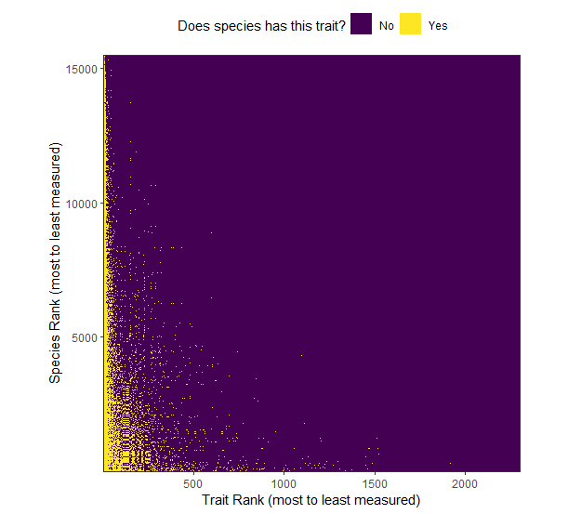
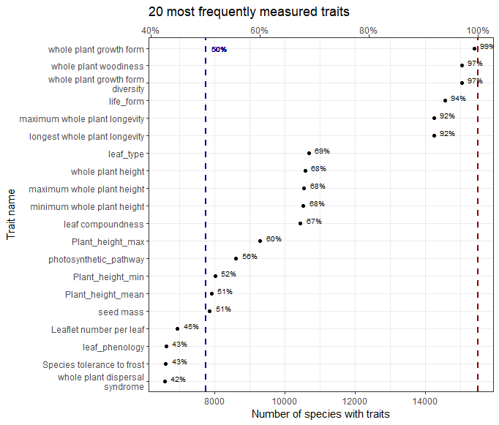
Few Consistently Measured Traits Top Measured Traits are not that Relevant
The species x trait matrix is mostly empty
Most commonly measured traits are not that ecologically insightful

Slide 6

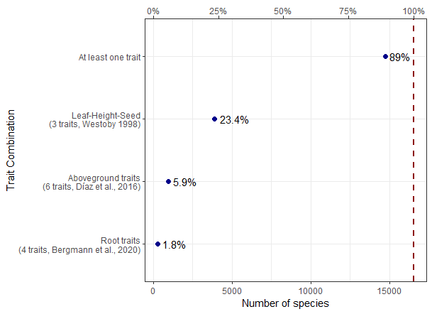
Trait combinations are not that often measured
We’re not only interested by isolated measurements
We need multiple traits to describe species’ phenotype
“Classical” combinations can be used
…but are not available for most aliens

Slide 7

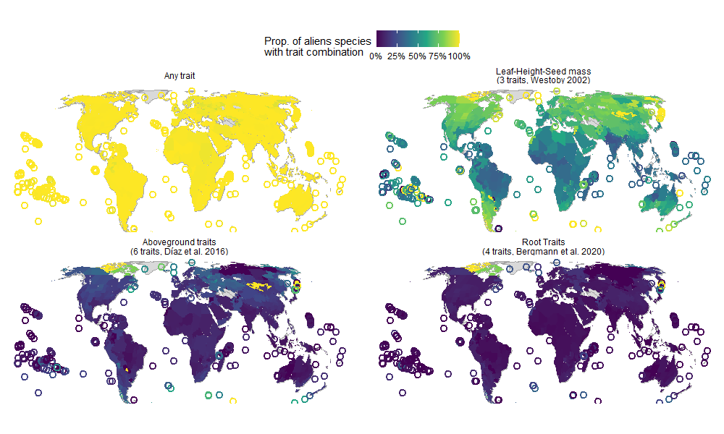
Little exotic species are known worldwide

Slide 8

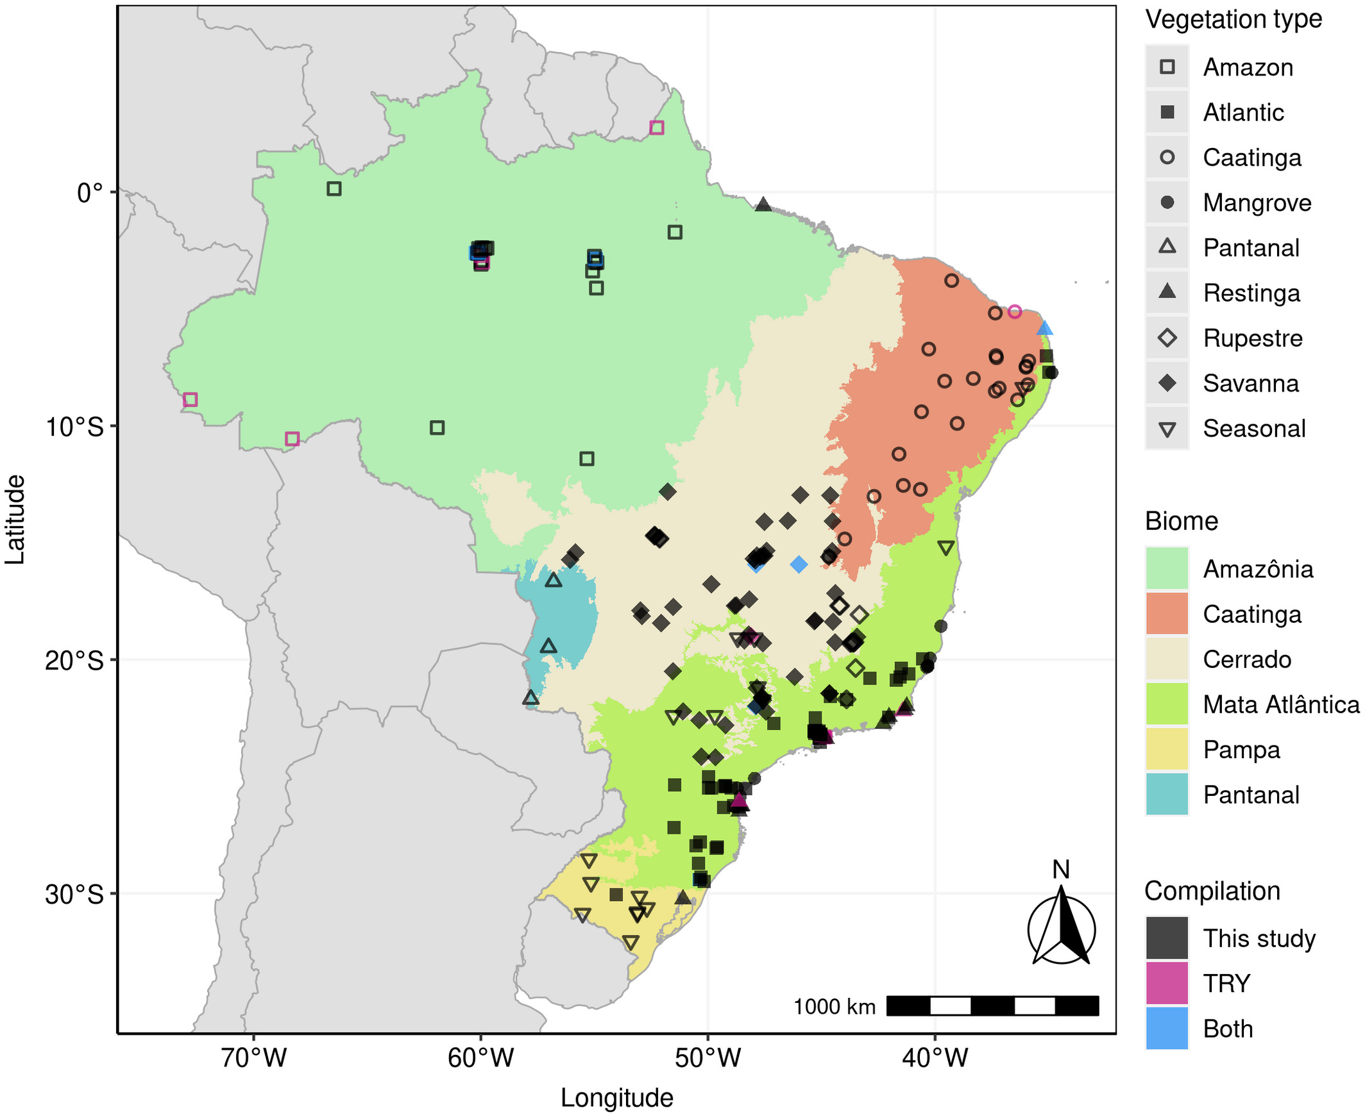
Closing the gaps: a needed community effort
Trait not in databases ≠ Trait not measured
It’s possible to close the gaps!
Species x Locations x Traits Prioritization
Targeted Literature Search
Community Data Compilation
Distributed Field Campaign
Mariano et al. 2021 (GEB)
Let’s do it as a community!

Slide 9


@LeNematode
https://rekyt.github.io/
Thank you!

